Slide 1

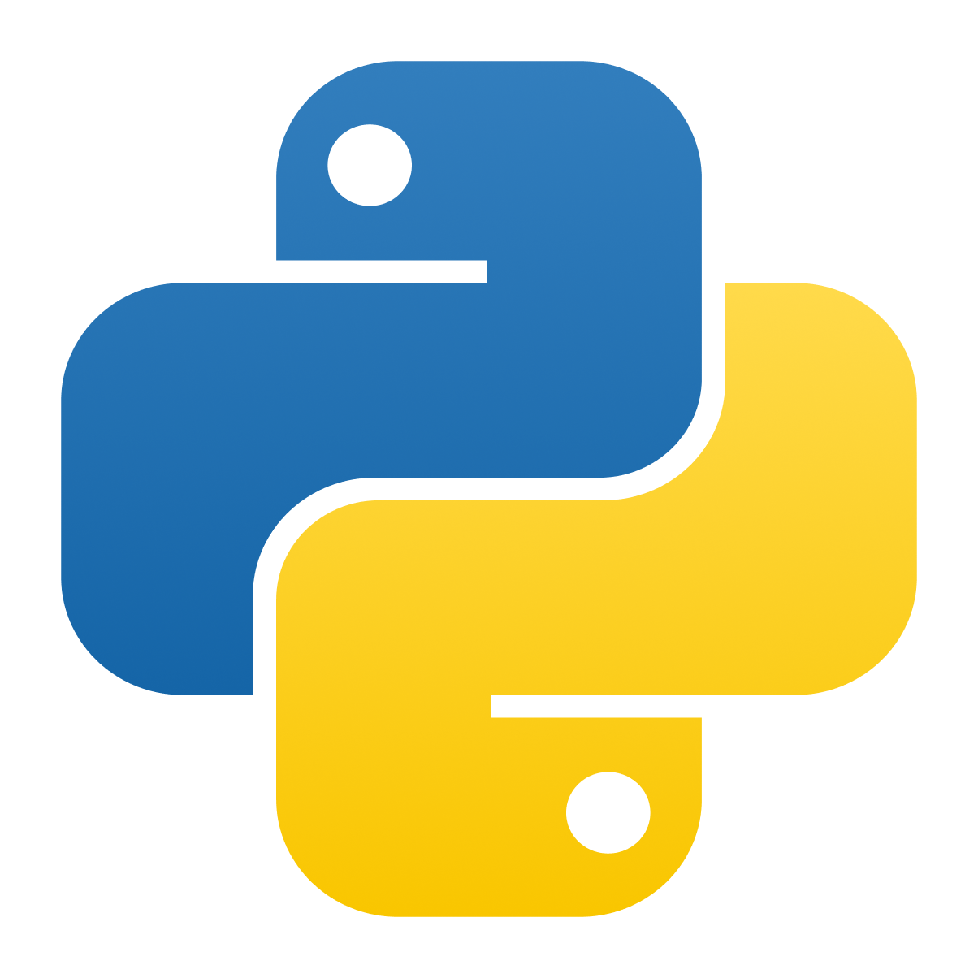


INTRODUCTION TO PROGRAMMING

Slide 2


Programming
Programming
Giving precise instructions to a computer to make things happen.
Giving precise instructions to a computer to make things happen.
Programming = Problem solving → figuring out how to achieve a goal step by step.
Programming = Problem solving → figuring out how to achieve a goal step by step.
Let’s say you were tasked to write a set of instructions to draw a square. How would you approach this ?
Let’s say you were tasked to write a set of instructions to draw a square. How would you approach this ?

Slide 3

Programming
Programming
from ColabTurtle.Turtle import * initializeTurtle() pencolor("red") right(90) forward(150) right(90) forward(150) right(90) forward(150) right(90) forward(150)
Just Draw a Square innit.

Slide 4
Why Python?
using System; using System.Drawing; using System.Windows.Forms; class TurtleForm : Form { private Pen pen = new Pen(Color.Red, 2); public TurtleForm() { this.Text = "Turtle Square Example"; this.Size = new Size(400, 400); this.Paint += new PaintEventHandler(DrawSquare); } private void DrawSquare(object sender, PaintEventArgs e) { Graphics g = e.Graphics; // Starting position (like turtle) int x = 100; int y = 100; int size = 150; // Draw the square step by step g.DrawLine(pen, x, y, x + size, y); // top g.DrawLine(pen, x + size, y, x + size, y + size); // right g.DrawLine(pen, x + size, y + size, x, y + size); // bottom g.DrawLine(pen, x, y + size, x, y); // left } ...
Advantages: Easy to read and write Fast to develop Large libraries and community Easy to debug Disadvantages: Slower execution than compiled languages Higher memory usage Not ideal for mobile apps or low-level programming

Slide 5




Functions
Think of it as a verb, something that performs an action when you call it.
input/argument
print("Hello World")
Name
NOTE: Double quotes are used to help differentiate between the text (String) and the code.
Paranthese

Slide 6
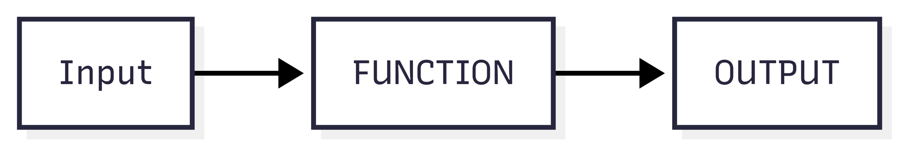
Functions
You give it input, it process this input, and it *may give an output (return value).

Slide 7




Variables
A variable is a store of data. You could assign whatever value you want to a variable and access that same data while the program is running
A string input is expected
user_input = input("What is your name?")
The string will be assigned to the variable user_input at runtime

Slide 8





Data Types
A variable can be stored in various different data types. In this workshop we will cover strings, ints, floats, booleans.
Boolean
Numeric
Sequence
Var1 = 69 var2 = 4.2 var3 = 3 + 4j
var1 = “Apple” Var2 = [True,2,“Apple”] var3 = (True,2,“Apple”)
Var1 = True var2 = False var3 = 0 var4 = 1
Other
Var1={“a”:1,“p”:2,“l”:1,“e”:1} var2={1,2,2,3}

Slide 9
Strings
Text, letters, or words inside quotes.
s = "Hello" len(s) # gives length → 5 s.upper() # converts to uppercase → 'HELLO' s.lower() # converts to lowercase → 'hello' s + "!" # concatenation → 'Hello!' s[0] # access first character → 'H'
NOTE: use of Single Quotes for strings is not universal. In low level languages like C/C++ or Rust single quotes are reserved for individual characters.

Slide 10
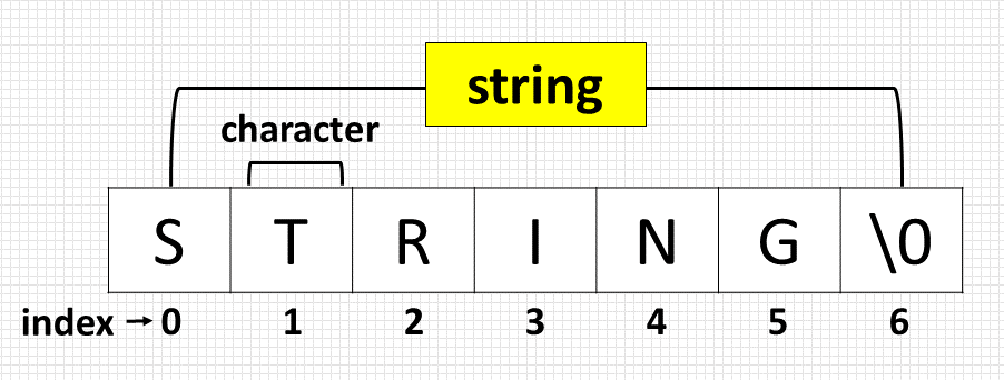
Strings
NOTE: the use of the term characters appose to letters, indeed we can virtually have any text value like emojis and escape characters.

Slide 11
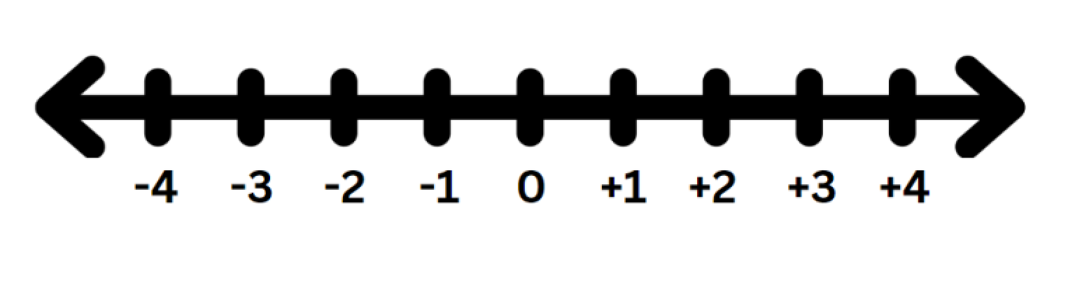
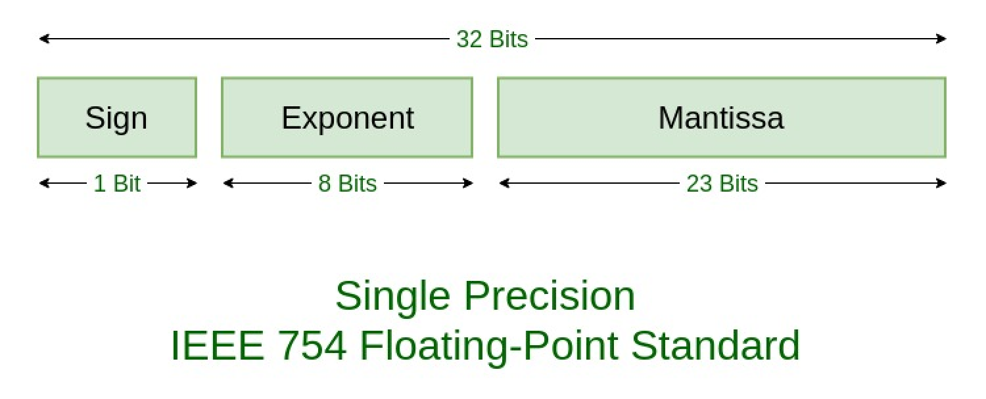
Integers & Floats
Integer(int): Any whole number (positive or negative) includes 0.
Floats(float): Any Decimal Real Number (i.e 3.14159)

Slide 12
Integers & Floats
NOTE: Python supports theoretically numbers that are infinitely large. The int type has no max limit.
print(float("inf"))
Floats (decimal numbers) aren’t always perfectly precise, so tiny rounding errors can happen.
print(0.1 + 0.2) # might show 0.30000000000000004

Slide 13
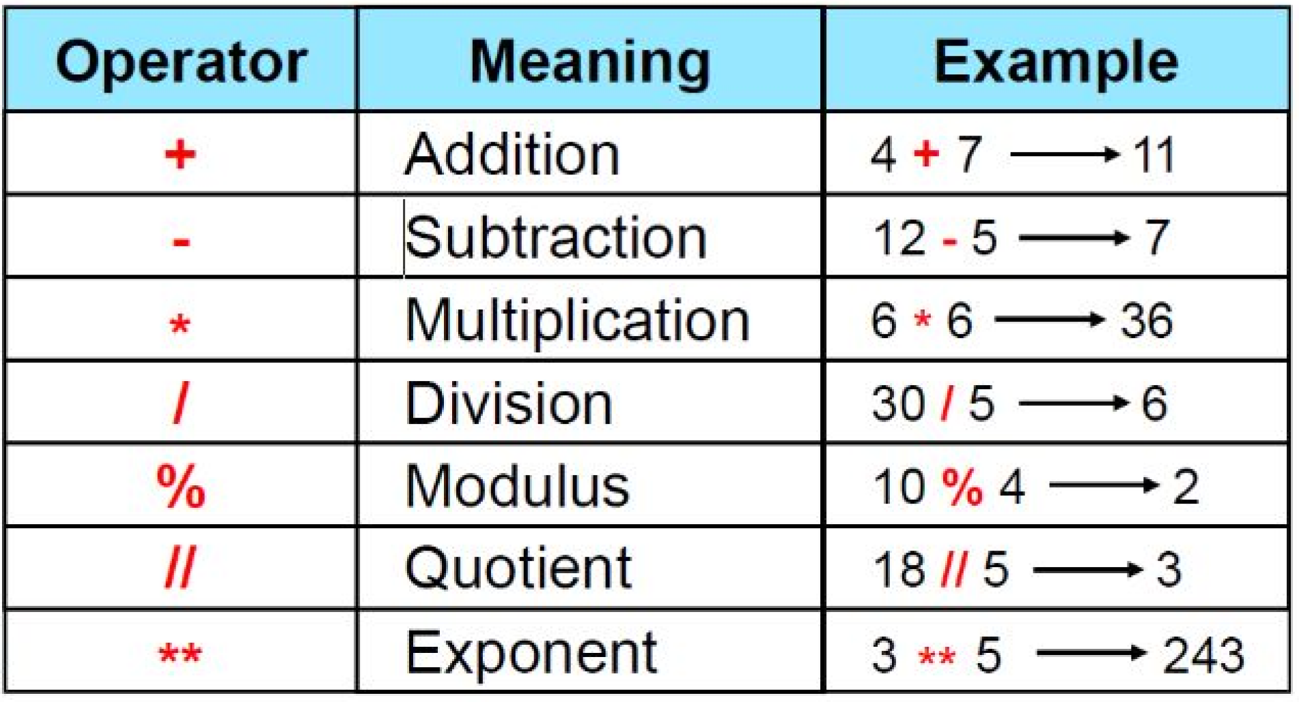
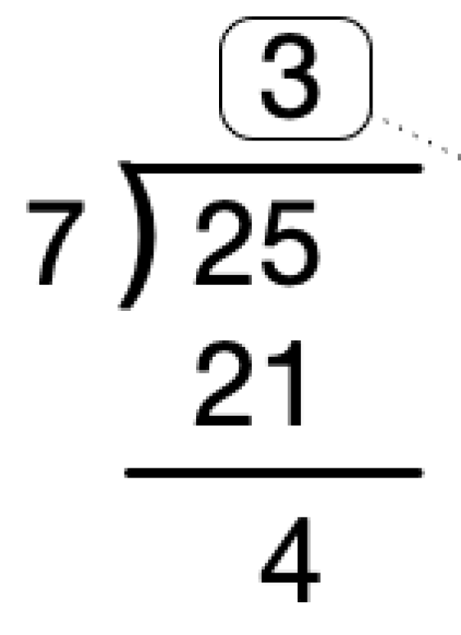


Arithmetic Operators
I’m certain everyone is familiar with +=*/ but note Modulus and Quotient.
Quotient
Modulus/remainder

Slide 14
Casting
Purpose: Convert text numbers (e.g., "123") to integers for calculations.
Function: Use int() to cast a string to an integer.
num = int("42") print(num + 8) # 50
Error Handling: Non-numeric strings cause Value Error. Always ensure the string represents a valid number before casting.

Slide 15
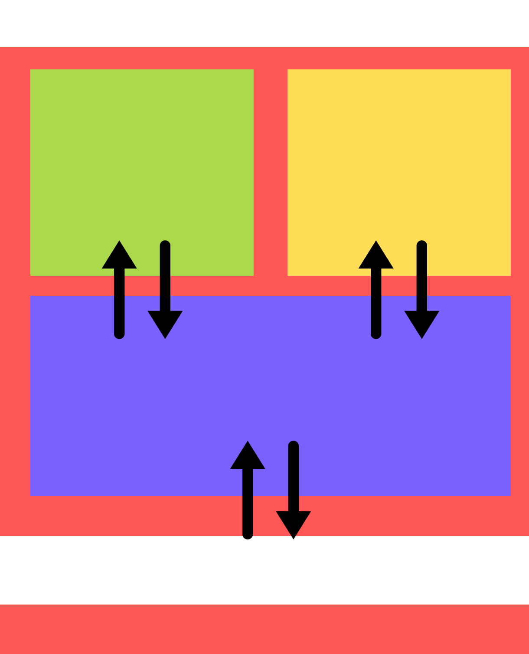




Memory
Harvard Architecture
The computer only holds a variable while the program is running.
Storage
Memory
Stack
Heap
thing1
“Apple”
CPU
thing1 = "Apple" thing2 = "Apple"
thing2
INPUT /OUTPUT DEVICES

Slide 16




Create A Function
We can create our own functions using this syntax.
inputs
def my__first_function(parameter1, parameter2): # Processing inside the function happens here. value = parameter1 + parameter2 return value # Return the processed data.
outputs

Slide 17

Create A Function
Let pretend we are the Python Interpreter and walk through the program.
def hello(to = "world!"): return f"Hello, {to}" print(hello()) user_input = input("What is your name?") print(hello(user_input))
Start Here

Slide 18
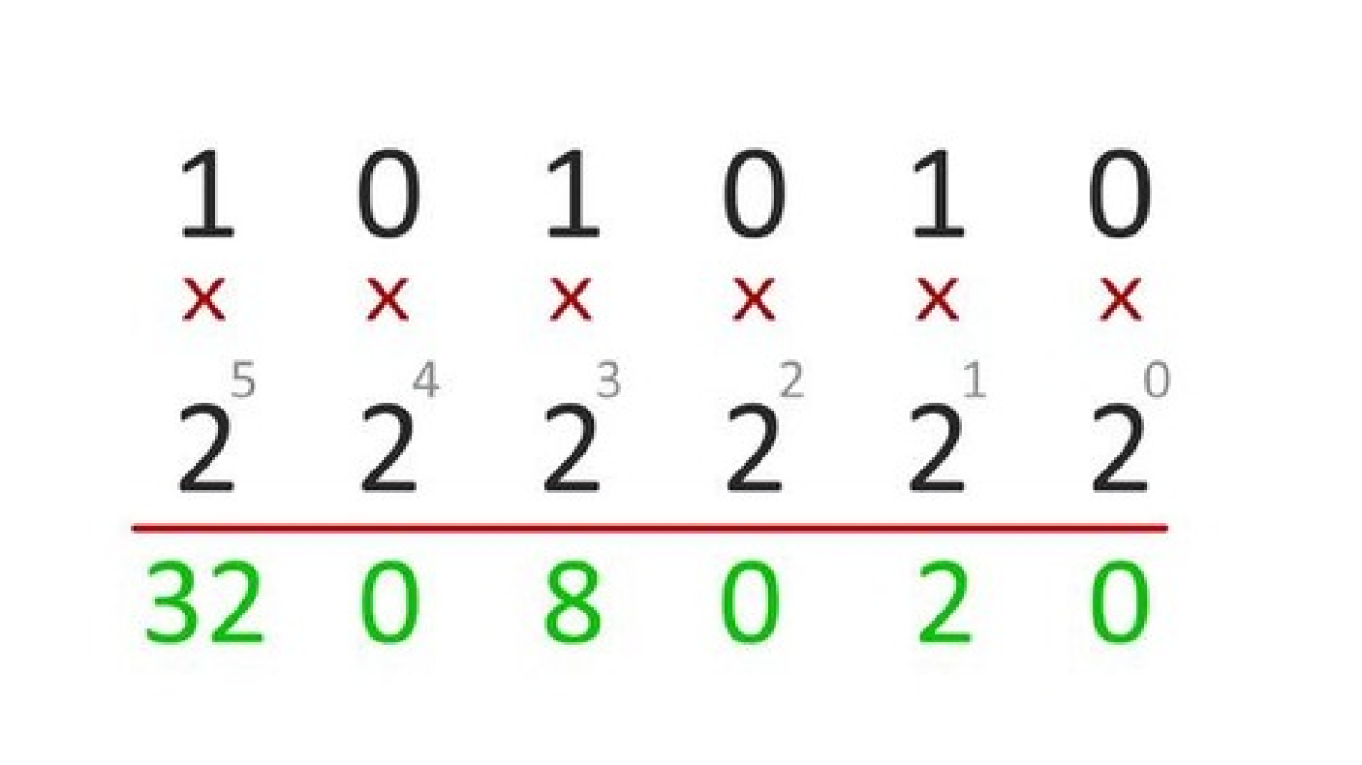
Boolean
Boolean : A value that’s either True or False (1 or o)
NOTE: Computer brains or Processors are made of billions of little gates called transistors and is the fundamental building block upon which everything is built up.

Slide 19

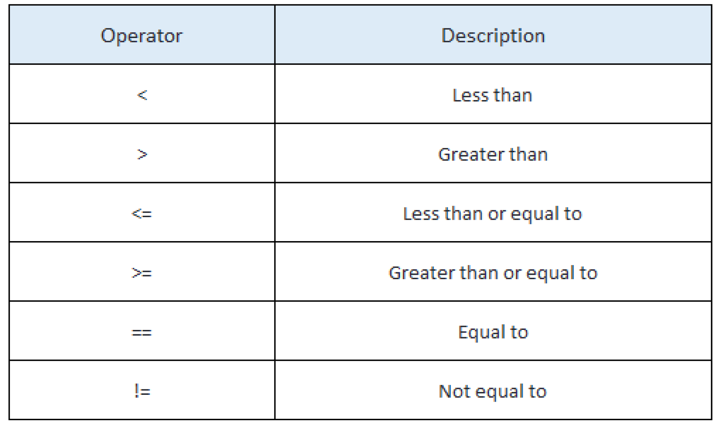

Relational Operators
NOTE: Assignment operator “x = y” is not the same as equality operator “x == y”. Earlier we telling the program to remember a certain for later. Now we are asking it to compare x and y and return True if x does equal y and False if it doesn’t.

Slide 20




Conditionals
SIDE NOTE: Input function gets user input and returns it as a string which is cast(converted) into an integer
input1 = int(input()) input2 = int(input()) if input1 > input2: print(f"{input1} is greater than {input2}") if input1 < input2: print(f"{input1} is less than {input2}") if input1 == input2: print(f"{input1} is equal to {input2}")
IF STATEMENTS: runs the code directly underneath if the boolean expression that proceeds evaluates to True

Slide 21
Conditionals
SIDE NOTE: Input function gets user input and returns it as a string which is cast(converted) into an integer
input1 = int(input()) input2 = int(input()) if input1 > input2: print(f"{input1} is greater than {input2}") if input1 < input2: print(f"{input1} is less than {input2}") if input1 == input2: print(f"{input1} is equal to {input2}")
IF STATEMENTS: runs the code directly underneath if the boolean expression that proceeds evaluates to True

Slide 22

Conditionals
This approach leads to multiple redundant checks. If input1 is greater than input 2 it can’t also then be less than or equal to

Slide 23
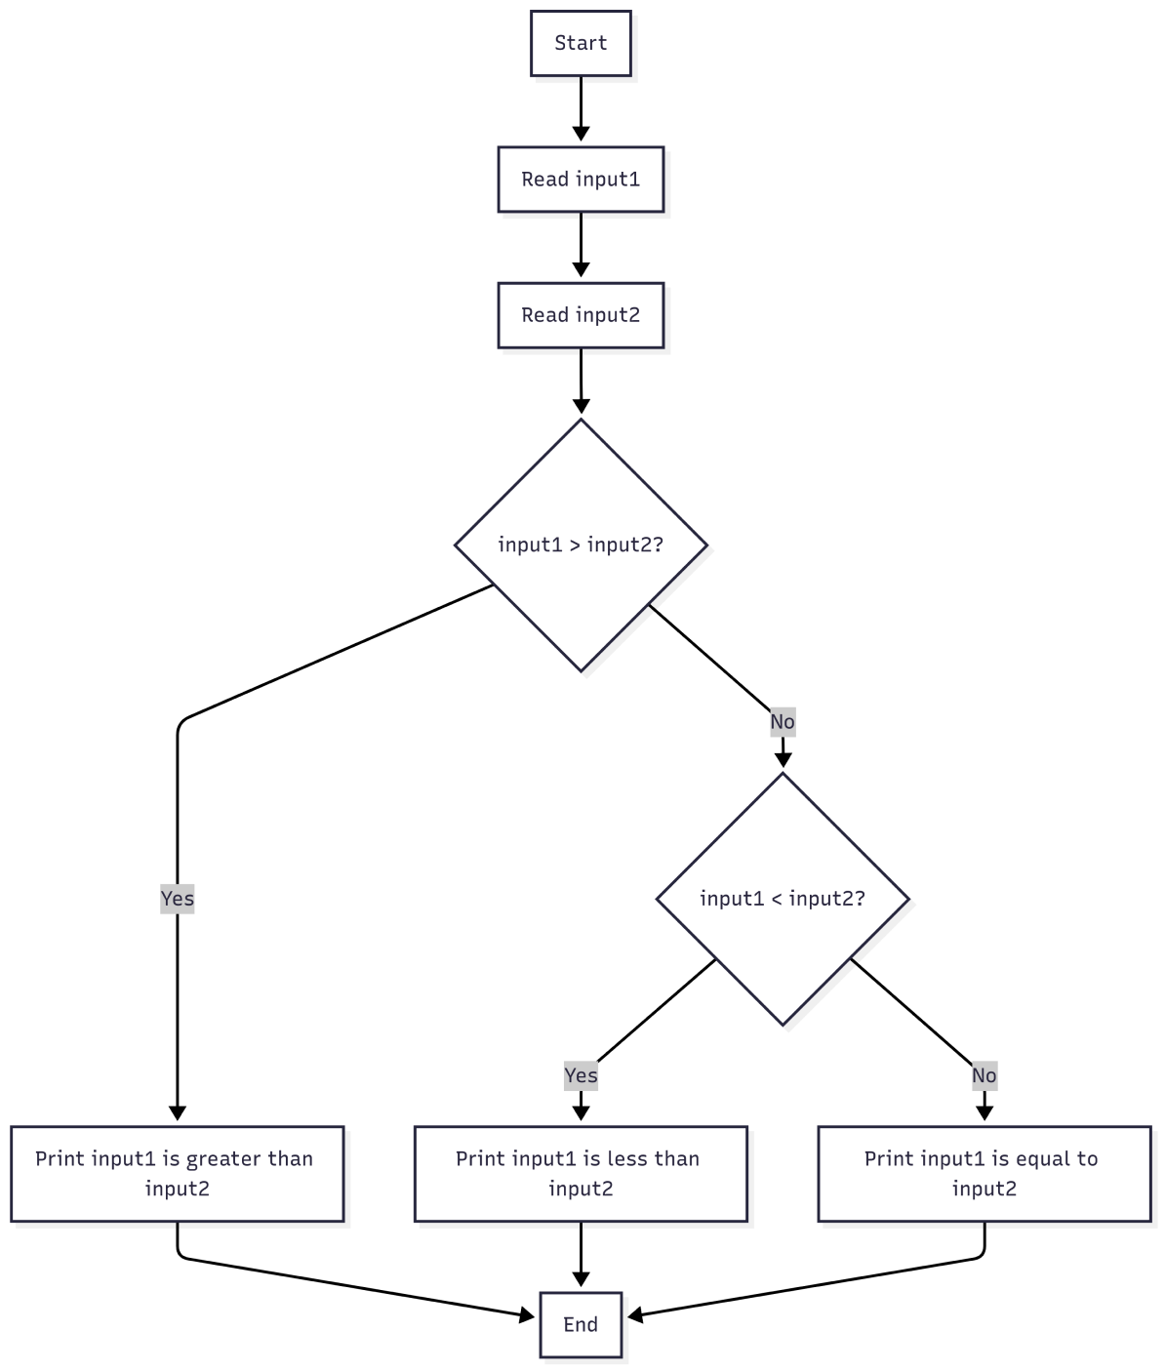
Conditionals
Now there’s less redundant checks.
Assuming we just want to know whether the two inputs are the same, what can we do to make this even simpler?

Slide 24
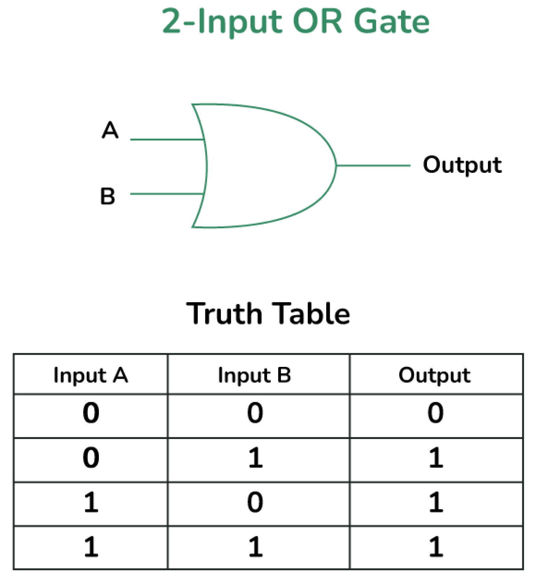
Logical Operators
A
B
if input1 > input2 or input1 < input2: print("input 1 does not equal to input 2")

Slide 25
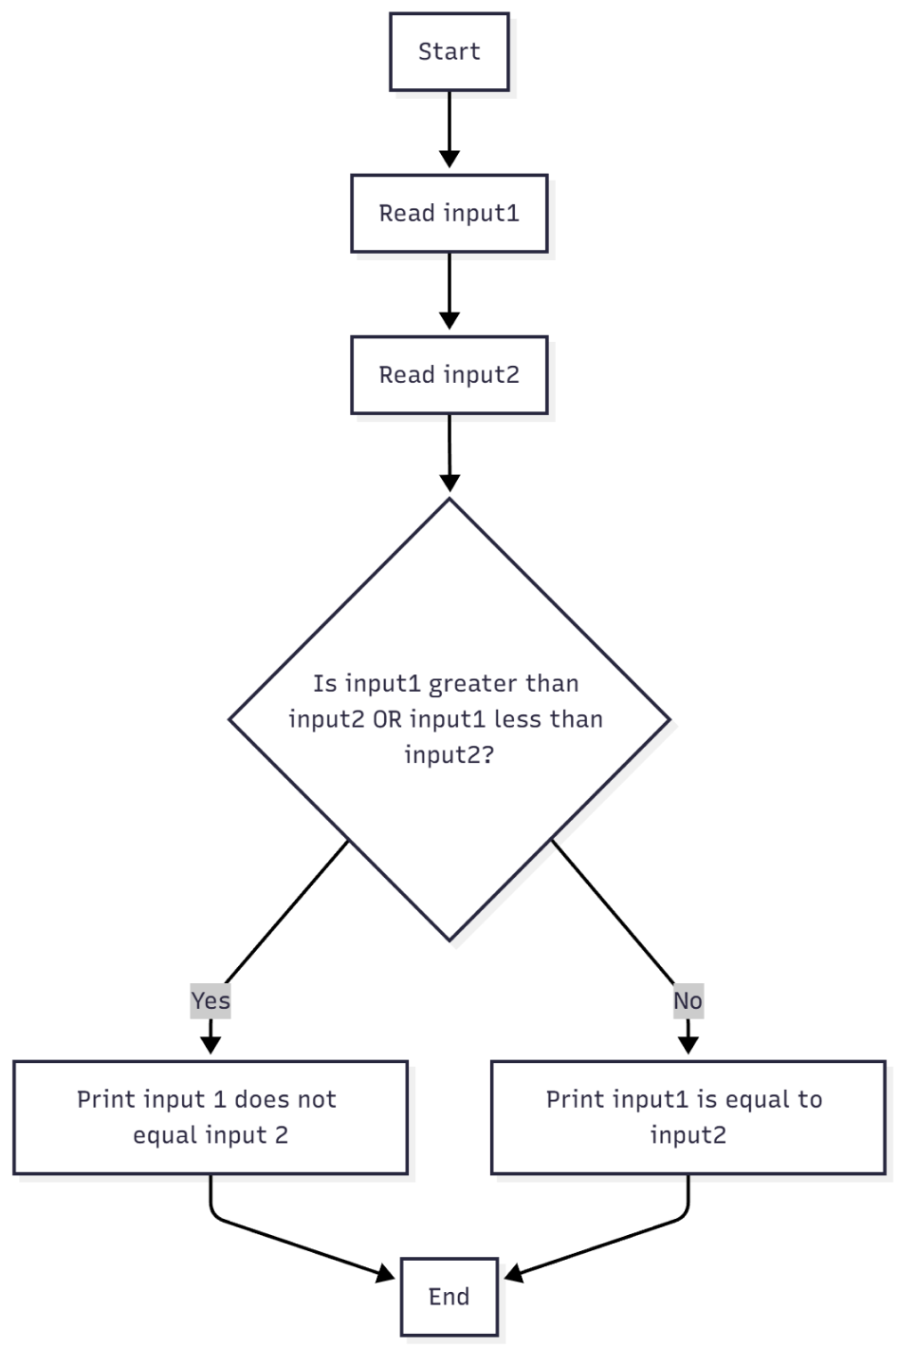

Conditionals
This is what the control flow of the best case situation Would look like

Slide 26
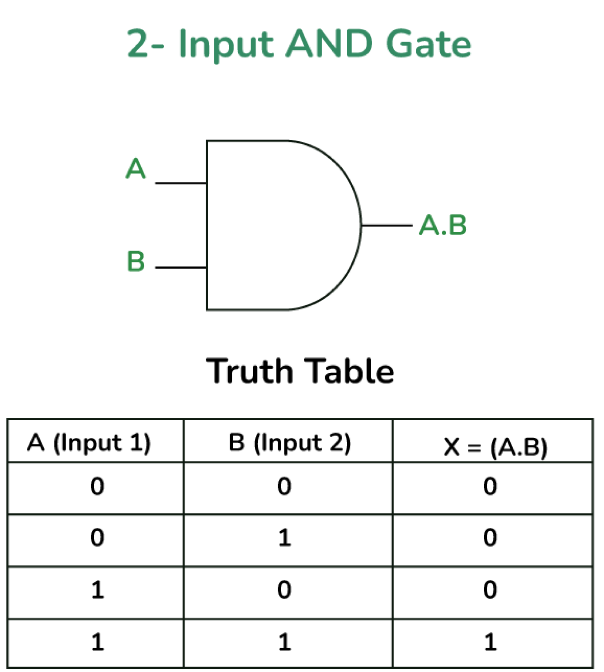
Logical Operators
If both the first statement and second statement is True the conditions are met to run the code.
A
B
if score >=70 and score <= 100: print("1:1")

Slide 27


Loops
Let you simplify repetitive tasks.
NOTE: we’re copy pasting the same code 4 times in this example, but the instructions to the human being just states “repeat 3 more times”. Loop effectively emulate this!

Slide 28
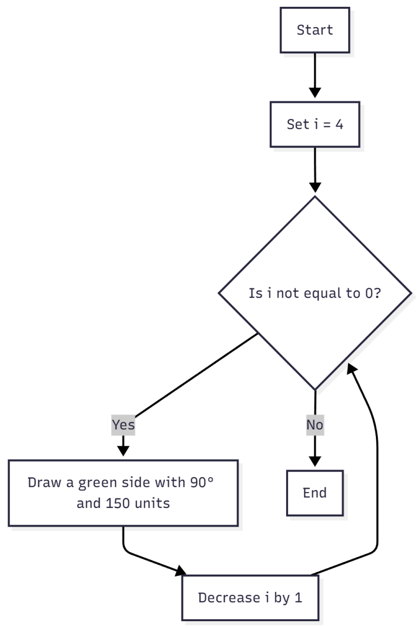


While
WHILE LOOP: runs the code WHILE the condition is true.

Slide 29
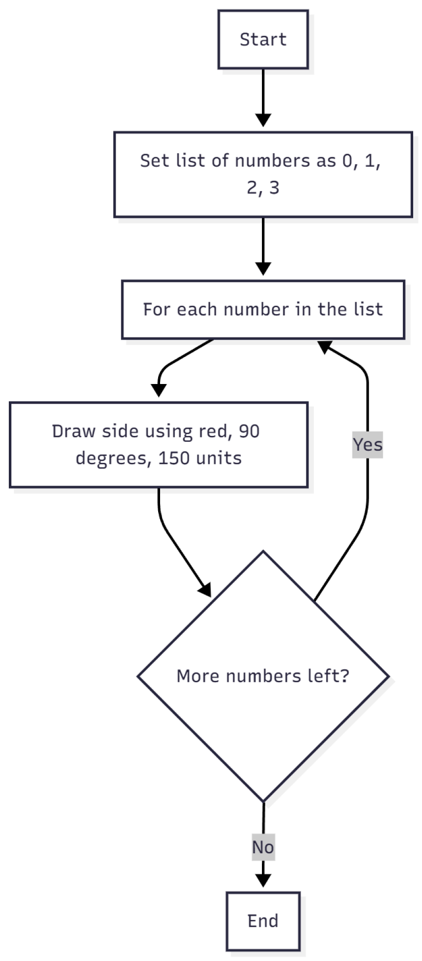


For-Each
FOR-EACH LOOP: let you go through each item in a collection, one by one:
for i in [0,1,2,3]: print(f"{i}")
NOTE: we’re counting back from 4 until i == 0 at which point the condition i != 0 is false and the code in the loop no longer runs.

Slide 30
List
A list is a collection of items stored in order. Think of it like a shopping list or a playlist multiple items in one container.
NOTE: Brackets are used to declare the start and end of a list, with items separated by commas.

Slide 31
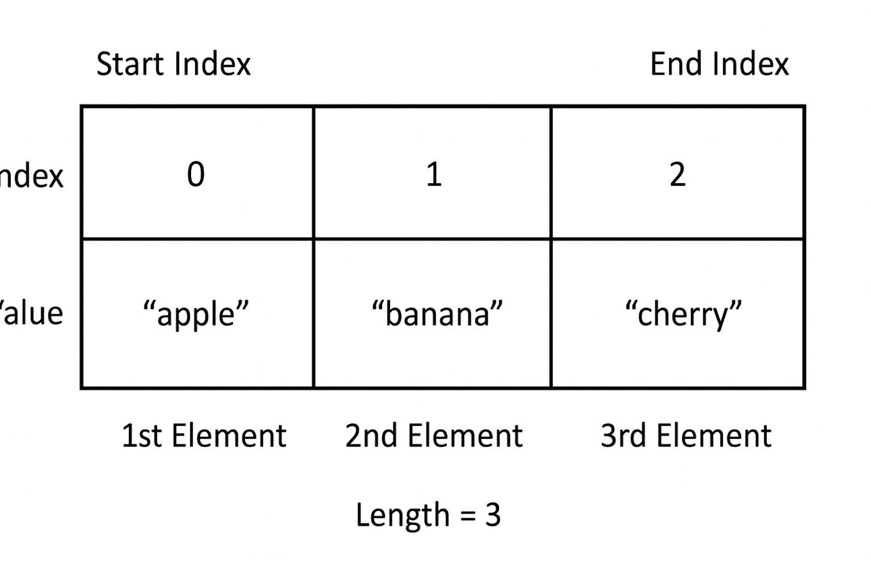



List
Indexing in programming starts from 0 (exceptions being Lua, Fortran, MATLAB & R).
fruits = ["apple", "banana", "cherry"] fruits[0] # "apple" fruits[1] # "banana"
NOTE: Brackets are also used outside of assigning the variable to access data stored in the list. list_name[index] to get corresponding value.

Slide 32





List
Lists come with a bunch of functionality.
fruits = ["apple", "banana", "cherry", "date", "elderberry", "fig"] numbers = [1, 2, 3, 4, 5, 6]
length: Returns the length of a list.
len(fruits) # 6
Negative Index: index backwards and access items in the end.
fruits[-1] # "cherry" (last item)
Slicing: cut out part of a string by declaring start index, end by index, and the step.
fruits[1:4:1] # ["banana", "cherry", "date"]
Adding to a list
Removing from a list

Slide 33
List vs Strings
# List letters = ["h", "e", "l", "l", "o"] print(letters[0]) # "h" print(len(letters)) # 5
# String word = "hello" print(word[0]) # "h" print(len(word)) # 5
Key difference: Strings are immutable (can't change), lists are mutable (can change) while the program is running.
letters = ["h", "e", "l", "l", "o"] letters[0] = "H" # ✅ Works! ["H", "e", "l", "l", "o"]
word = "hello" word[0] = "H" # ❌ ERROR! Can't modify strings

Slide 34



Tuples
A tuple is like a list, but you CAN'T change it after creation. Just like a string it’s immutable.
coordinates = (10, 20) colors = ("red", "blue", "green") mixed = (42, "hello", 3.14) single = (5,)
Note: tuples have practically the same functionality as lists while being much faster and more safe. Python can reserve memory more efficiently since it can never be changed.

Slide 35



Set
A set is an unordered collection with NO duplicates. They behave very similar to sets in Mathematics.
NOTE: curly brackets are used to declare the start and end of a set, with items separated by commas.
colors = {"red", "blue", "green"} numbers = {1, 2, 3, 4, 5} empty = set() # NOT {} - that makes an empty dictionary!
A set of unique tags, a collection of student IDs (no duplicates allowed). Members can be checked fast.

Slide 36




Dictionaries
A collection of key-value pairs where each key points to a value. Look up information by name/identifier instead of by position
Key
person = {'name': 'John', 'age': 25, 'hobbies': ['coding', 'gaming']}
value
Values can be anything Strings, Integers, Lists, even other dictionaries where as keys have to be immutable. Look up information by name/identifier instead of by position

Slide 37



Comparison
Lists/Tuples: Sequential access by position → "Give me the 3rd item" (index-based)
Sets: Direct access for membership → "Is this item here?" (hash-based)
Dictionaries: Direct access by key → "Give me John's phone number" (hash-based)

Slide 38
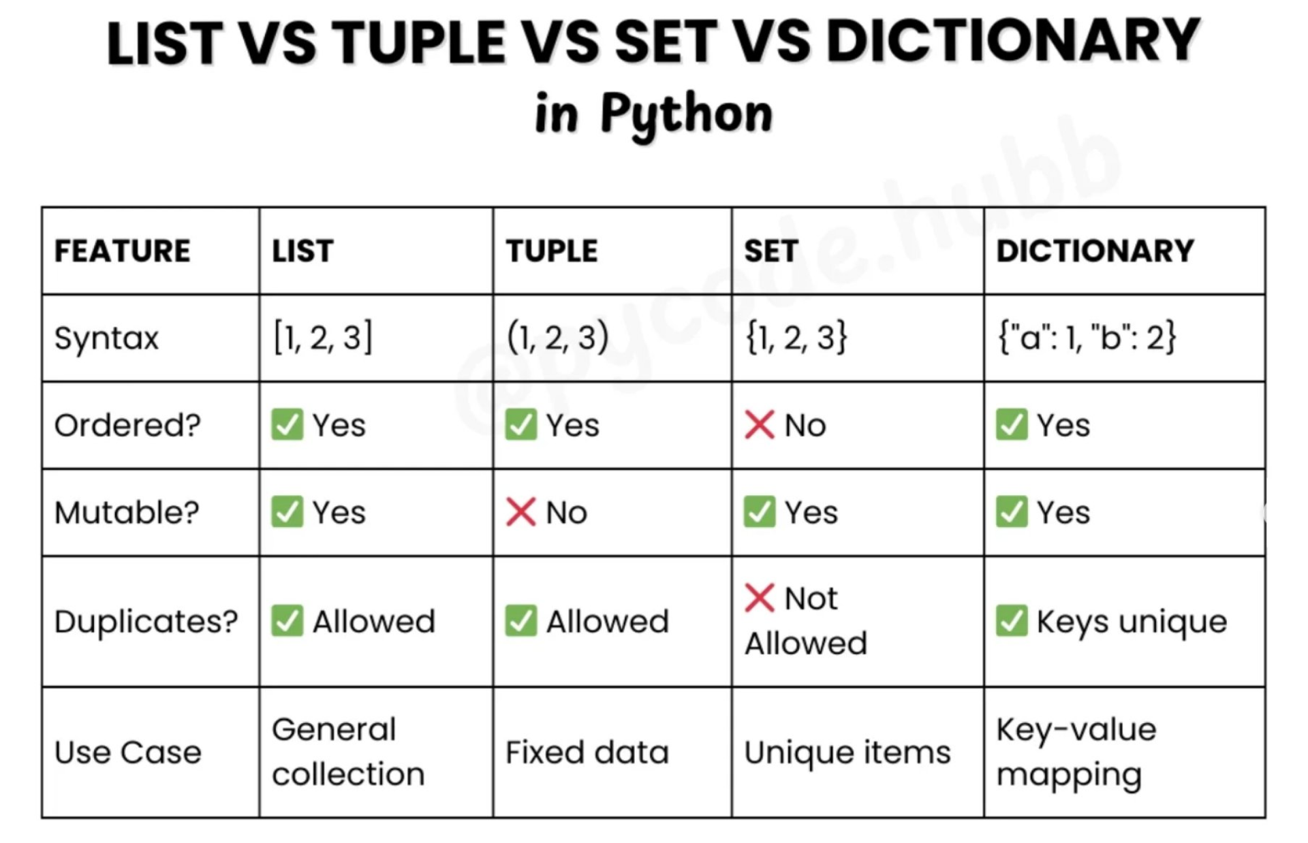
Comparison
Both use hashing for O(1) constant-time lookups, unlike lists which need O(n) sequential search

